Slide 1
HIRING PROCESS ANALYTICS

Slide 2
PROJECT OVERVIEW
The project's objectives are to examine a company's hiring practices, pay scale, departmental organization, and job levels. The purpose of the data collection is to offer insights into the gender distribution of recent hires, average compensation, salary distribution throughout time intervals, departmental ratios, and position distribution across tiers. The strategy makes use of visuals and data analysis tools to extract valuable information from the company's dataset.

Slide 3
APPROACH USED
Data Cleaning: To begin, load the dataset and look for any values that are missing. To guarantee that the dataset is full, choose a suitable procedure for handling these missing values.
Clubbing Categories: Where appropriate, combine columns with several categories to simplify the collection.
Outlier Detection and Removal: To find and deal with outliers in the dataset, apply statistical techniques.
Statistical Analysis: To summarise the data, compute important statistical measures such averages and medians.
Visualization: To help people better grasp the data and visually represent the findings, create graphs and charts.

Slide 4
TECH STACK USED
Microsoft Excel 2021:- Objective of using it :
Cleaning and Preparing Data: Excel was utilized to ensure that the data was accurately prepared for analysis as well as to clean and preprocess it.
Gender Distribution Analysis: The company counted the number of men and women hired by using Excel tools and algorithms.
Salary Analysis: The average salary of employees was determined using Excel functions such as AVERAGE.
Salary Distribution: To determine the salary distribution, the data was grouped into class intervals using Excel's data analysis toolkit.
Data Visualization: To display departmental proportions and position tier distribution, a variety of charts and graphs, including pie charts and bar graphs, were made using Excel's built-in charting features.

Slide 5
INSIGHTS
Insights based on hen given tasks are:-
Hiring Analysis: The hiring process involves bringing new individuals into the organization for various roles. The analysis showed the proportion of males and females hiring. There are total 7169 people who interviewed for a particular job in the company, out of which around 57% of the proportion was males and the remainig 43% were females. Here, gender imbalance signifies more inclusive hiring practices.
Salary Analysis: The average salary is calculated by adding up the salaries of a group of employees and then dividing the total by the number of employees. The average salary offered by the company is 49,978.01.

Slide 6
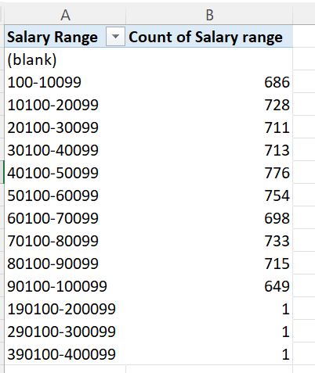
INSIGHTS continued…
Salary Distribution: Class intervals represent ranges of values, in this case, salary ranges. The class interval is the difference between the upper and lower limits of a class.
Implication- High concentration in mid range salaries suggests a focus on entry to mid level positions with limited high salaries.

Slide 7
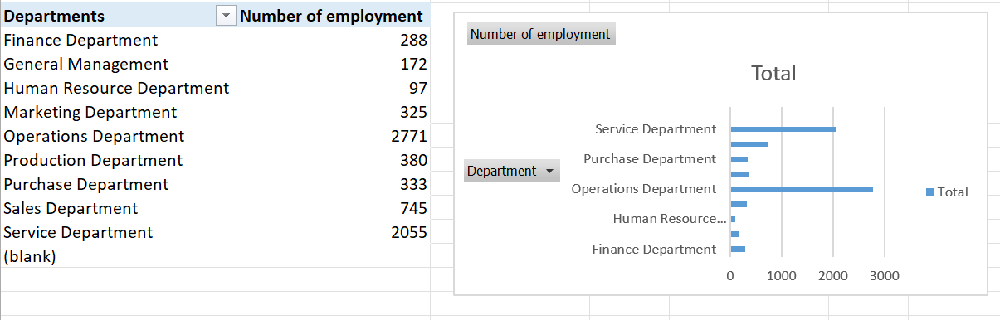
INSIGHTS continued…
Most common Salary Range- 40,100- 50,099 with 776 employees
High Frequency Ranges - 50,100- 60,099 with 754 employees and 70,100-80,099 with 733 employees
Low Frequency Ranges- 1,90,100- 4,00,00 with employment of 1 employee.
Departmental Analysis: Visualizing data through charts and plots is a crucial part of data analysis.

Slide 8
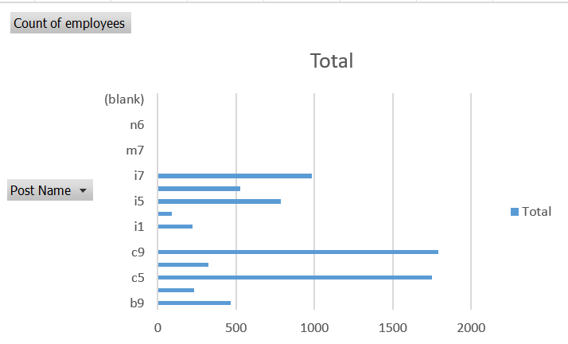
INSIGHTS continued…
From the graph we can draw an insight that Operation department has the maximum number of hiring followed by Service Department where as the Human Resource Department has the minimum one.
Position Tier Analysis: Different positions within a company often have different tiers or levels.

Slide 9
INSIGHTS continued…
From the bar chart you can review which post has maximum and minimum number of employment and can draw analyses over the level of tier.

Slide 10
RESULTS
Through the research, I was able to discover significant salary clusters and outliers and to do a thorough examination of the company's salary distribution. This project helped me better understand hiring process analytics by bringing to light alternative pay plans, the distribution of employee wages across various ranges, the concentration of salaries and it also helped me to boost up my Excel skills. It offered perceptions into the composition of the workforce, pay scales, and potential areas for pay practices development.

